Slide 1
Propel Pals
DJ Yuhn, Yuxi Mao, Stephanie Retzke

Slide 2
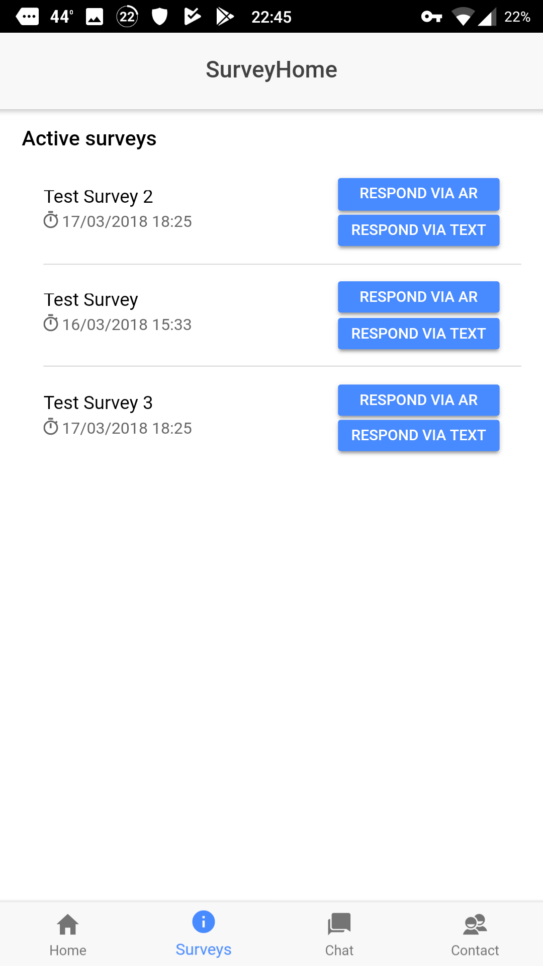
Survey Functionality
Used SurveyJS Library
Completed:
Pages with survey responses via text or AR
Can complete surveys
Needs Work:
Augmented Reality functionality not application specific
Surveys not removed on completion
Gaming element

Slide 3
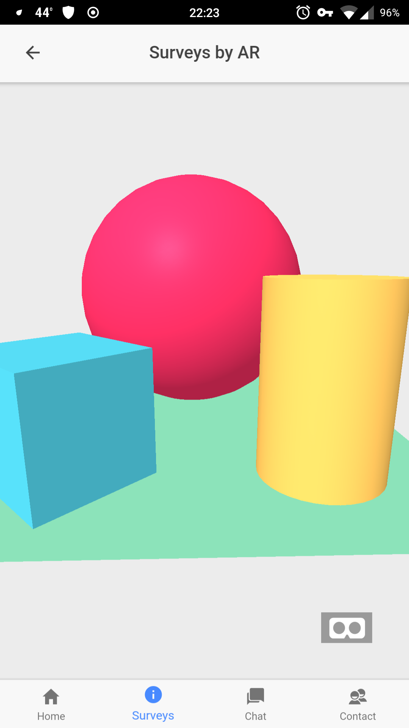
Augmented Reality Functionality
Used A-Frame framework
Completed:
Functionality works, not tailored to application specification
Can manipulate the view
Needs Work:
Implementing with survey functionality
Adding avatar to the view

Slide 4
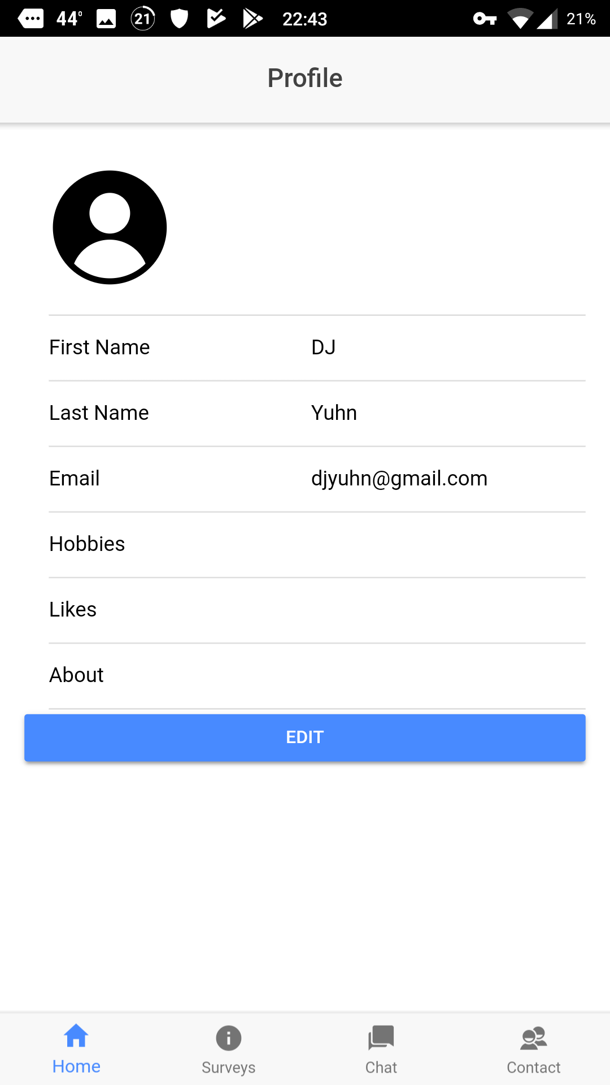
Profile Functionality
Completed:
Profiles incorporated into Firebase database
Can edit hobbies, likes, and give a summary
Profile image linked with chat
Needs Work:
Implementing gaming element (such as points) to the profile

Slide 5
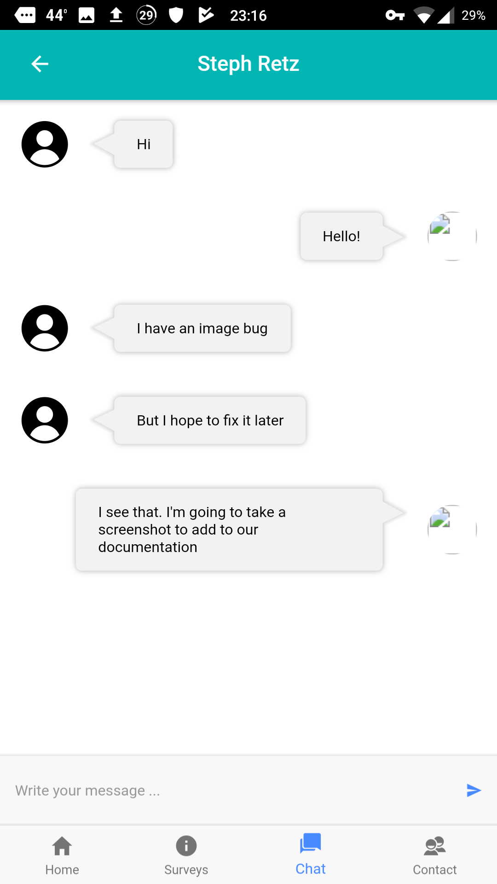
Chat Functionality
Completed:
Private chat with friends
Send and accept friend requests
Needs Work:
Group chat functionality
Send Images

Slide 6
Work To Be Completed
Implement AR in surveys
(Text to speech for avatar to ask surveys)
Add group chat
‘Beautifying’ the application
UMKC Twitter Feed
Gamification
Database Consistency

